Slide 1
Technical & Business Writing
Lecture 3
Noreen Shah

Slide 2
POWERFUL TOOLS FOR COMMUNICATING EFFECTIVELY
REDEFINING THE OFFICE
Thanks to advances in mobile and distributed communication, the “office” is no longer what it used to be. Technology lets today’s professionals work on the move while staying in close contact with colleagues, customers, and suppliers. These technologies are also redefining the very nature of some companies, as they replace traditional hierarchies with highly adaptable, virtual networks.

Slide 3

Web-Based Meetings
Web-based meetings allow team members from all over the world to interact in real time. Meetings can also be recorded for later playback and review. Various systems support instant messaging, video, collaborative editing tools, and more.

Slide 4
Videoconferencing and Telepresence
Videoconferencing provides many of the beneits of in-person meetings at a fraction of the cost. Advanced systems feature telepresence, in which the video images of meeting participants are lifesized and extremely realistic.

Slide 5
Shared Online Workspaces
Online workspaces help teams work productively, even if they are on the move or spread out across the country. In addition to providing controlled access to shared files and other digital resources, some systems include such features as project management tools and real-time document sharing (letting two or more team members view and edit a document on screen at the same time)

Slide 6
Voice Technologies
Speech recognition (converting human speech to computer commands) and speech synthesis (converting computer commands to human speech) can enhance communication in many ways, including simplifying mobile computing, assisting workers who are unwilling or unable to use keyboards, and allowing “one-sided” conversations with information systems. Speech analytics software can evaluate conversations to improve customer service and other interactions. Mobile VoIP lets people make voice calls on WiFi networks to save connection and roaming charges.

Slide 7
Mobile Business Apps
As the range of business software applications on smartphones and tablet computers continues to expand, almost anything that can be accomplished on a regular computer can be done on a mobile device (although not always as efficiently or with the same feature sets)

Slide 8
Instant Messaging
Instant messaging (IM) is one of the most widely used digital communication tools in the business world, replacing many conversations and exchanges that once took place via email or phone calls. Enterprise IM systems are similar to consumer IM systems in many respects but have additional security and collaboration features. Group messaging systems add file sharing and information management tools to help teams work more efficiently.

Slide 9
COLLABORATING AND SHARING INFORMATION
The need to work with and share information quickly and easily is a constant in business. A wide variety of tools have been developed to facilitate collaboration and sharing, from general purpose systems such as instant messaging to more specialized capabilities such as data visualization.

Slide 10
Crowdsourcing and Collaboration Platforms
Crowdsourcing, inviting input from groups of people inside or outside the organization, can give companies access to a much wider range of ideas, solutions to problems, and insights into market trends.

Slide 11
Wikis
Wikis promote collaboration by simplifying the process of creating and editing online content. Anyone with access (some wikis are private; some are public) can add and modify pages as new information becomes available.

Slide 12
Data Visualization
Data visualization is a powerful tool for presenting and exploring sets of data that are very large, complex, or dynamic. As more companies rely on “big data” to identify and capitalize on market opportunities, the ability to extract insights from these large data sets can be an important competitive advantage.

Slide 13
Internet of Things
The Internet of Things (IoT) refers to the billions of smart, autonomous devices that are now connected via the Internet. These “things” are sensors, controllers, and other devices that send, receive, or process data. This machine-based communication can support or even replace conventional methods of business communication.

Slide 14
CONNECTING WITH STAKEHOLDERS
Electronic media and social media in particular have redefined the relationships businesses have with internal and external stakeholders. Any groups affected by a company’s decisions now have tools to give voice to their opinions and needs, and companies have many more conversational threads that need to be monitored and managed.

Slide 15
Applicant Tracking Systems
Applicant tracking systems now play a huge role in employment-related communications. At virtually all large companies and many medium and small companies, your résumé and application information will be entered into one of these systems. Recruiters use various tools to identify promising candidates and manage the interview and selection process. After hiring, some firms use talent management systems to track employee development through workers’ entire careers at the company

Slide 16
Online Video
The combination of low-cost digital video cameras and videosharing websites such as YouTube has spurred a revolution in business video. Product demonstrations, company overviews, promotional presentations, and training seminars are among the most popular applications of business video. Branded channels allow companies to present theirvideos as an integrated collection in a customized user interface.

Slide 17
Blogging
Blogs let companies connect with customers and other audiences in a fast and informal way. Commenting features let readers participate in the conversation, too.

Slide 18
Content Curation
Content curation, selecting videos and other items of interest to followers of a website or blog, has become one of the most popular ways to connect with stakeholders. Pinterest and Scoop.it are among the leading technologies in this area.

Slide 19
Podcasting
With the portability and convenience of downloadable
audio and video recordings, podcasts have become
a popular means of delivering everything from college
lectures to marketing messages. Podcasts are also
used for internal communication, replacing
conference calls, newsletters, and other media.

Slide 20
User-Generated Content Sites
User-generated content sites let businesses host photos, videos, software programs, technical solutions, and other valuable content for their customer communities.

Slide 21
Microblogging
Microblogging services (of which Twitter is by far the best known) are a great way to share ideas, solicit feedback, monitor market trends, and announce special deals and events.

Slide 22
BUILDING COMMUNITIES
One of the most significant benefits of new communication technologies is the ease with which companies can foster a sense of community among customers, enthusiasts, and other groups. In some instances, the company establishes and manages the online community, while in others the community is driven by product champions or other enthusiasts.

Slide 23
Gaming Technologies
Adding game-playing elements to business processes (such as competitions for sales or service teams) can increase engagement from employees and customers alike.

Slide 24
Social Networking
Businesses use a variety of social networks as specialized channels to engage customers, find new employees, attract investors, and share ideas and challenges with peers.

Slide 25
Community Q&A Sites
Many companies now rely heavily on communities of customers to help each other with product questions and other routine matters.

Slide 26
Committing to Ethical and Legal Communication
Ethics are the accepted principles of conduct that govern behavior within a society. Ethical behavior is a companywide concern, but because communication efforts are the public face of a company, they are subjected to particularly rigorous scrutiny from regulators, legislators, investors, consumer groups, environmental groups, labor organizations, and anyone else affected by business activities. Ethical communication includes all relevant information, is true in every sense, and is not deceptive in any way. In contrast, unethical communication can distort the truth or manipulate audiences in a variety of ways:

Slide 27
Plagiarizing. Plagiarism is presenting someone else’s words or other creative product as your own. Note that plagiarism can be illegal if it violates a copyright, which is a form of legal protection for the expression of creative ideas.54
Omitting essential information. Your audience must have all the information necessary to make an intelligent, objective decision.
Selective misquoting. Distorting or hiding the true intent of someone else’s words is unethical.
Misrepresenting numbers. Statistics and other data can be unethically manipulated by increasing or decreasing numbers, exaggerating, altering statistics, or omitting numeric data.
Distorting visuals. Images can be manipulated in unethical ways, such as altering photos to deceive audiences or changing the scale of graphs and charts to exaggerate or conceal differences.
Failing to respect privacy or information security needs. Failing to respect the privacy of others or failing to adequately protect information entrusted to your care can also be considered unethical (and is sometimes illegal).
Transparency gives audience members access to all the information they need in order to process messages accurately.

Slide 28
DISTIngUIShIng EThICAL DILEMMAS FRoM EThICAL LAPSES
An ethical dilemma is a choice between alternatives that may not be clearly right or clearly wrong.
An ethical lapse is a clearly unethical choice. With both internal and external communication efforts, the pressure to produce results or justify decisions can make unethical communication a tempting choice. Telling a potential customer you can complete a project by a certain date when you know you can’t is simply dishonest, even if you need the contract to save your career or your company. There is no ethical dilemma here.

Slide 29
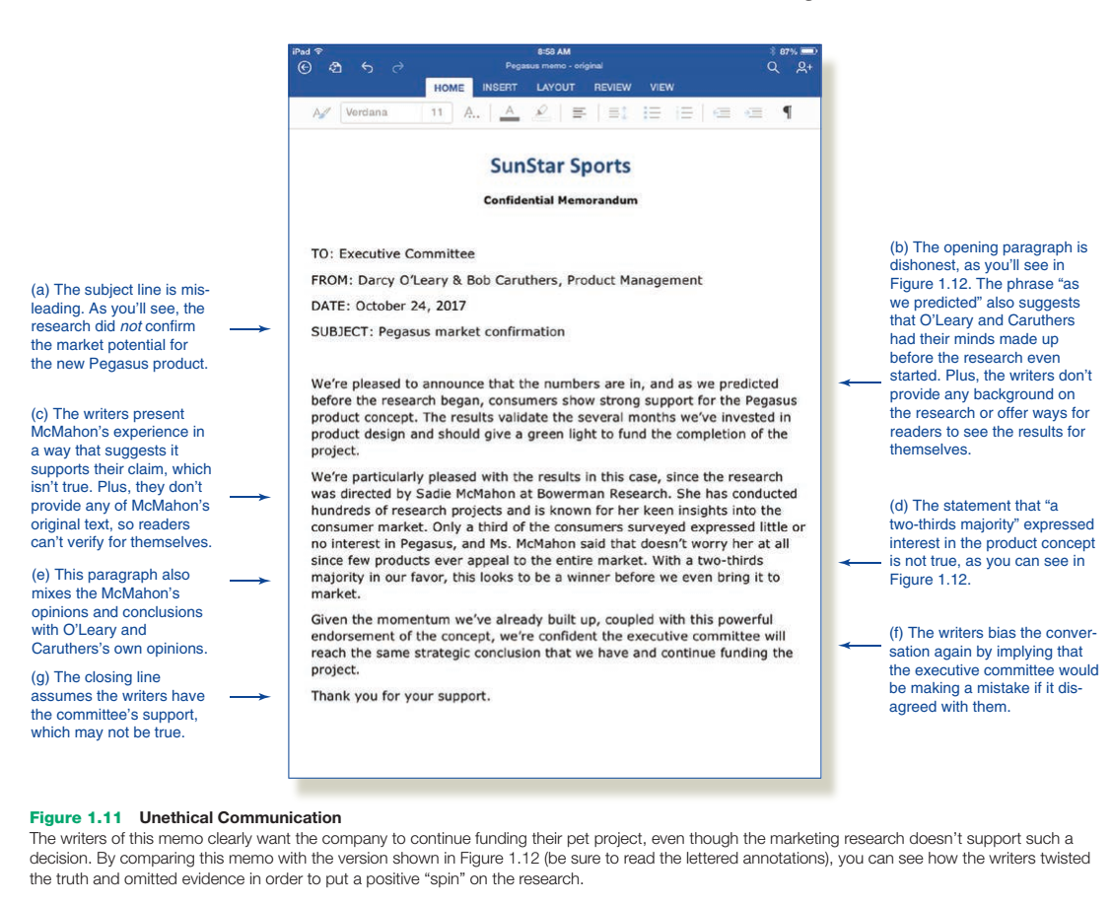

Slide 30
EnSURIng EThICAL CoMMUnICATIon
Ensuring ethical business communication requires three elements: ethical individuals, ethical company leadership, and the appropriate policies and structures to support employees’ efforts to make ethical choices.58 Moreover, these three elements need to work in harmony. If employees see company executives making unethical decisions and flouting company guidelines, they might conclude that the guidelines are meaningless and emulate their bosses’ unethical behavior.

Slide 31
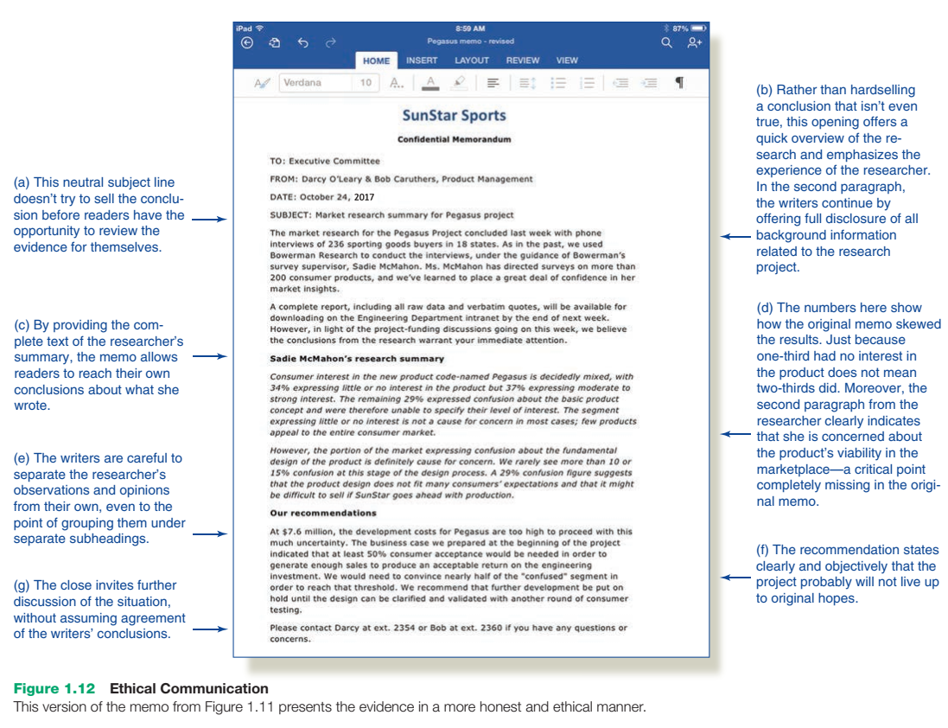

Slide 32
ETHICAL GUIDELINES
Responsible employers establish clear ethical guidelines for their employees to follow. Many companies establish an explicit ethics policy by using a written code of ethics to help employees determine what is acceptable. A code is often part of a larger program of employee training and communication channels that allow employees to ask questions and report instances of questionable ethics. To ensure ongoing compliance with their codes of ethics, many companies also conduct ethics audits to monitor ethical progress and to point out any weaknesses that need to be addressed.

Slide 33
However, whether or not formal guidelines are in place, every employee has a responsibility to communicate in an ethical manner. In the absence of clear guidelines, ask yourself the following questions about your business communications:
Have you defined the situation fairly and accurately?
What is your intention in communicating this message?
What impact will this message have on the people who receive it or who might be affected by it?
Will the message achieve the greatest possible good while doing the least possible harm?
Will the assumptions you’ve made change over time? That is, will a decision that seems ethical now seem unethical in the future?
Are you comfortable with your decision? Would you be embarrassed if it were printed in tomorrow’s newspaper or spread across the Internet? Think about a person whom you admire and ask yourself what he or she would think of your decision.

Slide 34
ENSURING LEGAL COMMUNICATION
● Promotional communication. Marketing specialists need to be aware of the many laws that govern truth and accuracy in advertising. These laws address such issues as product reviews written by bloggers who receive compensation from the companies involved, false and deceptive advertising, misleading or inaccurate labels on product packages, and bait-and-switch tactics in which a store advertises a lower-priced product to lure consumers into a store but then tries to sell them a more expensive item.60 Chapter 12 explores this area in more detail.
●● Contracts. A contract is a legally binding promise between two parties in which one party makes a specified offer and the other party accepts. Contracts are fundamental to virtually every aspect of business, from product sales to property rental to credit cards and loans to professional service agreements.61
●● Employment communication. A variety of local, state, and federal laws govern communication between employers and both potential and current employees. For example, job descriptions must be written in a way that doesn’t intentionally or unintentionally discriminate against women, minorities, or people with disabilities.

Slide 35
ENSURING LEGAL COMMUNICATION
● Intellectual property. In an age when instant global connectivity makes copying and retransmitting digital files effortless, the protection of intellectual property has become a widespread concern. Intellectual property (IP) includes patents, copyrighted materials, trade secrets, and even Internet domain names.63 Bloggers and social media users in particular need to be careful about IP protection, given the carefree way that some post the work of others without offering proper credit.
●● Financial reporting. Finance and accounting professionals who work for publicly traded companies (those that sell stock to the public) must adhere to stringent reporting laws. For instance, a number of corporations have recently been targets of both government investigations and shareholder lawsuits for offering misleading descriptions of financial results and revenue forecasts.
●● Defamation. Negative comments about another party raise the possibility of defamation, the intentional communication of false statements that damage character or reputation.64 (Written defamation is called libel; spoken defamation is called slander.) Someone suing for defamation must prove (1) that the statement is false, (2) that the language is injurious to the person’s reputation, and (3) that the statement has been published.

Slide 36
ENSURING LEGAL COMMUNICATION
● Transparency requirements. Governments around the world are taking steps to help ensure that consumers and other parties know who is behind the information they receive, particularly when it appears online. The European Union, for instance, outlaws a number of online marketing tactics, including “flogs,” short for “fake blogs,” in which an employee or a paid agent posing as an independent consumer posts positive stories about a company’s products.65 In the United States, FTC guidelines require bloggers and other social media users who review products to disclose if they receive compensation for writing reviews.66
If you have any doubts about the legality of a message you intend to distribute, ask for advice from your company’s legal department. A small dose of caution can prevent huge legal headaches and protect your company’s reputation in the marketplace.

